Slide 1

Singapore Personal Crime Statistics
Anusuya Manickavasagam (A0163300Y)
Kesavan Sridharan (A0163207M)
Muni Ranjan (A0163382E)
Pradeep Kumar (A0163453H)

Slide 2
Overview
Organization
Singapore Police and other law enforcement agencies
Goal
Analysis personal crime in Singapore
Gain Insights in Personal Safety
Suggest Action Items Personal Safety

Slide 3
Data Collection
Gather Data from data.gov.sg
A sample of the data gathered
Crime in Singapore
Only Personal Crime Data Gathered
Data included age, gender, education
Remand admissions with respect to age, gender, education
Victims according to offence committed

Slide 4
Data Exploration
Raw data Exploration in MySQL Server
Identifying missing values
Identifying Primary keys
Data loaded in to Tableau
Performed joins on Contraband and Moneylending data
Offence groups in conviction and remand
Gender in conviction and remand

Slide 5
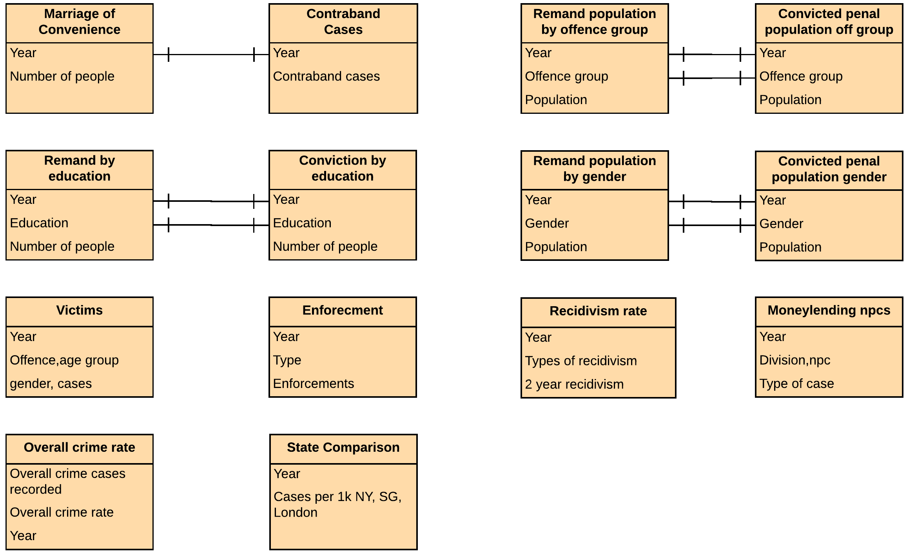
Data Model

Slide 6
GQM Storytelling framework
Audience
The Police department of Singapore
Law ministry
Crime Statistics wing
Goal
Find the insights for Crime data using visualization capabilities which otherwise is difficult to look directly from the data
Identify and define key performance indicators and suggest action items

Slide 7
GQM Storytelling framework
Key Questions
How is Singapore placed against other major cities
What is the current crime statistics of Singapore
What is the demography of the people in penal admissions
What are the major offences in Singapore
What are the victims types/count/rate over the years

Slide 8
GQM Storytelling framework
KPI Metrics
Crime rate
Offence type distribution
Over the year change in crime
Over the year change in Remand
Penal admission by age
Penal admission by gender
Penal admission by education
Total Moneylending cases

Slide 9
Few Insights
Woodlands is the hotspot for Money Lending cases
Drug offences and Property Crime tops the list
Secondary Level offenders are much higher than primary or no Education
Past 10 years conviction has decreased where remand has increased

Slide 10
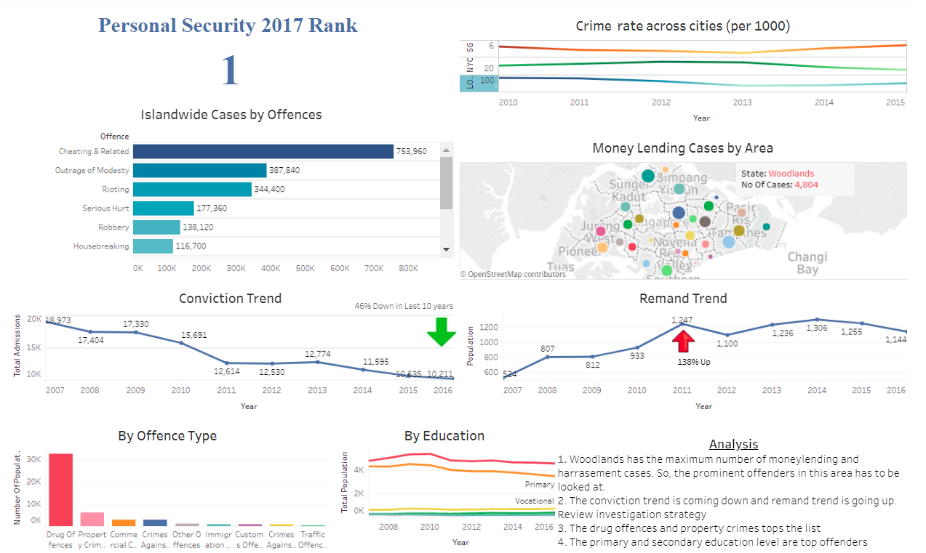
Public Tableau Available

Slide 11
References
Storyboard - Public Tableau link
Dashboard – Public Tableau Link
Data sources:
https://data.gov.sg/dataset?q=crime
http://safecities.economist.com/safe-cities-index-2017
https://www.ons.gov.uk/peoplepopulationandcommunity/crimeandjustice/datasets/crimeinenglandandwalesannualtrendanddemographictables
http://www1.nyc.gov/site/nypd/stats/crime-statistics/historical.page
Blog@Analytics:

Slide 12


